Slide 1
Accelerometer-based step detection
Ala Shaabana, Qiang Xu, Merhawit Berhane

Slide 2
Contributions
Implemented algorithm that combines the work of Ying et al. [2003] and Li et al. [2013].
Specifically, combined Derivative operator and Integration methods proposed by Ying et al., followed by low-pass FIR implemented by Li et al.
Introduced two thresholds while detecting peaks, and use a calibration module to estimate these thresholds.

Slide 5
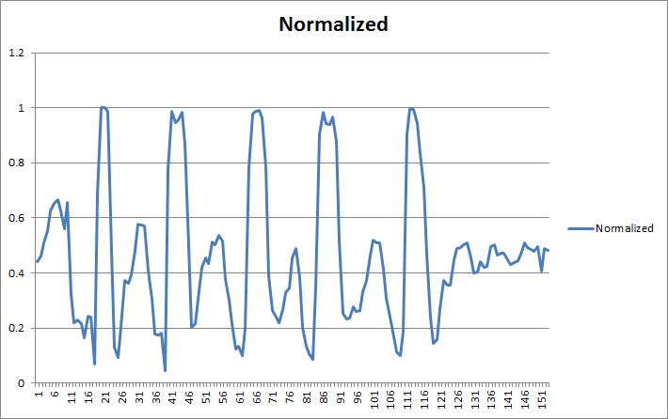

Slide 6
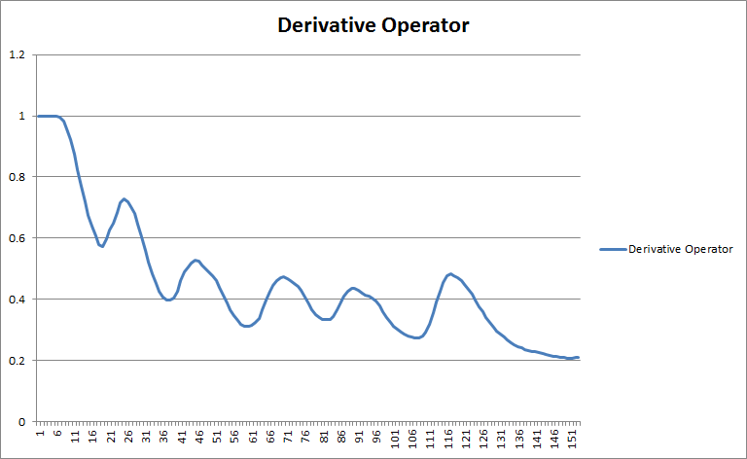

Slide 7
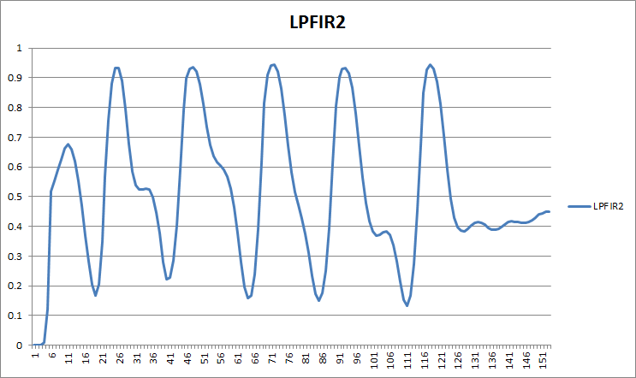

Slide 8
Walking, no calibration
Actual # of steps | Total steps detected | False Positives | False Negatives
10 | 10 | 0 | 0
20 | 20 | 0 | 0
30 | 29 | 1 | 0
40 | 39 | 0 | 1

Slide 9
Walking, after calibration
Actual # of steps | Total steps detected | False Positives | False Negatives
10 | 10 | 0 | 0
20 | 20 | 0 | 0
30 | 30 | 0 | 0
40 | 40 | 0 | 0
50 | 53 | 3 | 0

Slide 10
Jogging, no calibration
Actual # of steps | Total steps detected | False Positives | False Negatives
10 | 12 | 2 | 0
20 | 23 | 3 | 0
30 | 30 | 0 | 0
40 | 43 | 3 | 0
50 | 50 | 0 | 0

Slide 11
Jogging, after calibration
Actual # of steps | Total steps detected | False Positives | False Negatives
10 | 10 | 0 | 0
20 | 20 | 0 | 0
30 | 30 | 0 | 0
40 | 40 | 0 | 0
50 | 51 | 1 | 0

